Slide 1

Marketing Presentation for Thai To Go
CHEN XIUQIN & 050B
http://thaitogo.sg

Slide 2
Marketing Brief

Slide 3
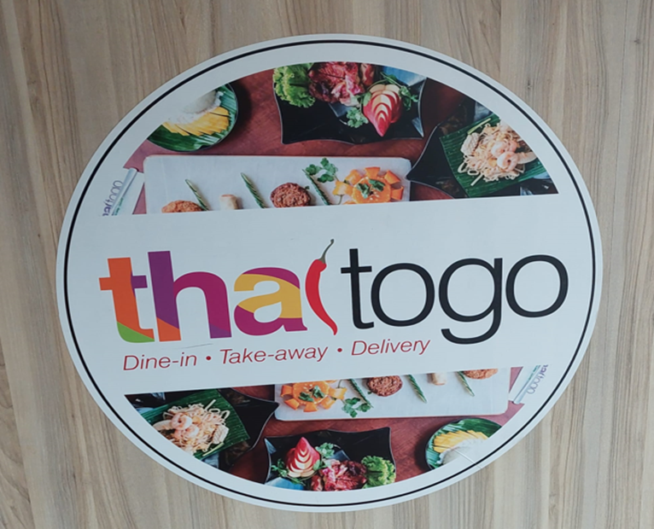
Company Background
Thai To Go is a halal Thai restaurant at Changi road near Eunos MRT
Offer
Order & Pickup
Island wide delivery
Dining In
Mini catering for min 10 pax (No license to do full catering)
In operation for 10 years already

Slide 4
Core Services & Persona
#1 - Island-wide Delivery
The restaurant offers delivery across the entire island, ensuring that customers from any location can enjoy their meals.
#2 - Dine-in
The restaurant provides seating for customers who prefer to enjoy their meals on-site.
#3 - In-Restaurant Catering
Customers interested in hosting a 20-40 pax gatherings or event at the restaurant.

Slide 5
Current Lead Generation
All leads are currently generated by
Word of mouth
Food Panda for delivery leads
https://www.foodpanda.sg/restaurant/w8kc/thai-to-go-changi-road
Leads Catering
https://www.foodline.sg/catering/Thaitogo/

Slide 6
Unique Value Proposition
"Thai To Go" is a Halal-certified Thai restaurant near Eunos MRT. It serves a mix of Thai, Malay, and Western food at more affordable price. The restaurant offers various menu options like bento boxes and lunch sets. They provide next-day mini catering and can host parties for up to 40 people, with a minimum order for 20 . The restaurant is also known for its personalized catering, adjusting dishes to suit individual preferences, such as spice levels.

Slide 7
Problem Statement
Since COVID-19, the business has slowed down because more people are working from home.
The goal is to increase orders, particularly deliveries , catering, and introduce special offers to attract customers.

Slide 8
Marketing Plan

Slide 9
Executive Summary
Marketing Objective
The main goal is to increase online orders by 20% within 3 months.
This will be done by improving digital marketing, especially through social media Ad, Google Ad, SEO, and an easy-to-use online ordering system. The aim is to raise brand awareness, bring more visitors to the website, and boost the number of completed orders.

Slide 10
Target Market:
Those who live in Singapore, aged between 25-45 years old, low to middle income and busy young professionals , particularly Malay families who are seeking affordable and convenient Halal food online ordering.

Slide 11
Target Persona
--- The target persona is Aliyah, she is a 35-year-old admin professional, married with two young children.
--- She represents busy, low to middle-income young professionals in Singapore.
--- Her main challenges are managing a tight budget and busy schedule.
--- She’s motivated by meals that are healthy, halal, and affordable.
--- She is also concerned about whether the online ordering process is easy, fast delivery, and whether there are family meal deals or discounts, all of which will influence her decision to order food online.

Slide 12

Persona / Ideal Customer
Demographic Information
Name | Aliyah
Age | 35
Occupation | Admin
Education Level | Polytechnic
Location | Near Eunos MRT Station
Single or Married? Any kids? | Married and has two children aged 7 and 5
Income Level | low income $30,000 annually ( Household income $ 65,000 )
Notes | --- Interest in Halal Thai food. ---Seeks convenient dining options that can accommodate her family’s needs.

Slide 13
Persona / Ideal Customer
Psychographic Information
Life stage | Married with young children (ages 7 and 5 )
Pain Points | Faces challenges in balancing her low income, busy schedule, while seeking affordable and convenient online ordering for her and her family
Motivations | A convenient meal ,such as family set meal that fits into her busy lifestyle, quick service options which are also healthy and halal with affordable prices.
Challenges | Uncertain whether restaurants will be able to provide orders without long waits, and reliable, affordable, halal-certified food.
Core Values & Beliefs | Values convenience and healthy eating, embraces easy online ordering, offers prompt delivery and takeaway options, and maintains transparency in food preparation and ingredients.

Slide 14
Persona / Ideal Customer
Service Needs & Preferences
Online Behaviour | Google Search: Usually uses Google to search for information including restaurant options, reviews, and specific halal food queries. Facebook and Instagram: Follows halal food-related pages, influencers, and local community groups.
Preferred Communication Channels | WhatsApp: Mainstream use for communication with people. Direct Messages Email: Newsletters
Service Expectations | Expect efficient service, authentic Thai flavors, fast ordering process and timely delivery.
Price Sensitivity | Expects reasonable pricing relative to the quality and portion sizes offered. family meal deals or discounts for children's meals.

Slide 15
Persona / Ideal Customer
Decision Making Process
Information Sources | Search Engine : Usually searches Google for anything that interests her Social Media: Facebook, Instagram, join groups and all content related to healthy eating, halal food, etc.
Influencers | Family: Meals need to accommodate the tastes and preferences of her spouse and young children. If the menu does not offer options that appeal to her entire family, she may be less likely to choose the service. Friend & Bloggers : Who focus on healthy living, especially those who offer halal meal ideas and tips for busy professionals and families.
Barriers to entry | Time Management: Busy Schedule, long working hours, especially with two young children. Financial Constraints: budget constraints may limit ordering in.
Decision Triggers | Quick and Easy Ordering: A streamlined, user-friendly online ordering process with minimal wait times would be appealing. Affordability and Value for Money: Offering affordable family set meals or discounts for larger orders would likely trigger a positive decision.

Slide 16
Executive Summary
Market Need:
Affordable Halal Thai food meal choices with flexible dining options like order & pickup, island-wide delivery, customizable meals, and venues for small gatherings.
Product Overview:
Caters to those who prefers the convenience of home or office delivery and customers looking to host small events or gatherings of 20-40 people.

Slide 17
Marketing Strategy:
--- Social Media : Post high-quality photos and videos of dishes, Highlight unique dishes and weekly specials, such as, special promotions to engage customer.
----Google Ad SEO:
Using long-tail keywords to capture specific search intent, such as "best halal Thai food delivery Singapore" or "affordable Thai catering for small groups”.
Ensure user friendly for easy ordering and payment on all platforms.

Slide 18

SWOT Analysis of The Company (Thai to go)
Strengths - ---Convenience: The restaurant is convenient, offering delivery and takeaway for busy customers. ---It has been around for 10 years, showing that it’s reliable and has a strong presence in the community. | Weaknesses – ---The restaurant relies on word of mouth, Food Panda, and Foodline for marketing which limits how many people hear about it. ---The menu is too limited and may not meet the needs of different customers, missing the chance to attract more people.
Opportunities – ---Digital Marketing Expansion: Use social media, and online ads more marketing channels to increase brand awareness and attract more customers. ---Offer affordable family packages or discounts on large orders, as well as special discounts for online customers with expiration dates。 | Threats – ---Strong competition from other Thai restaurants, local eateries, and international cuisine options. ---Negative reviews or poor online reputation management could damage the restaurant’s image and turn away potential customers.

Slide 19
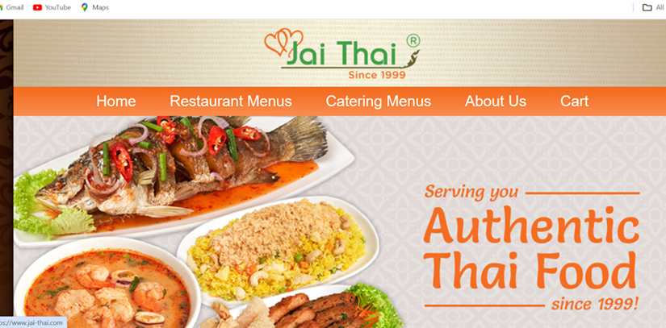
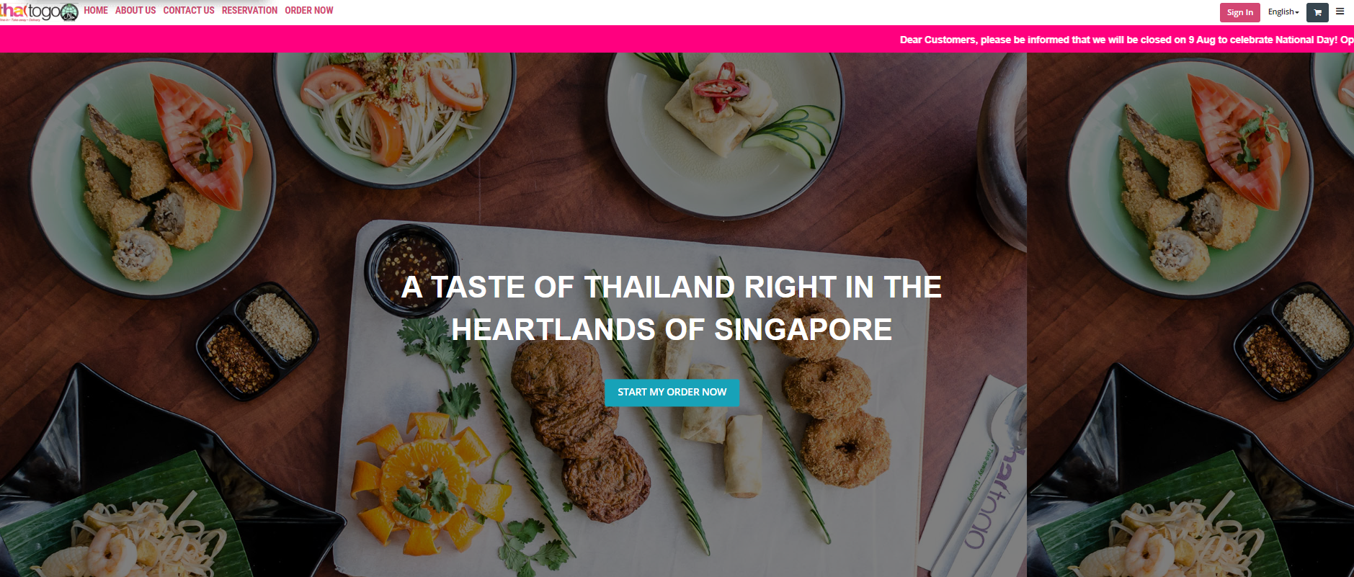
Competitive Analysis – Web https://www.jai-thai.com/ http://thaitogo.sg/12/Home

Slide 20
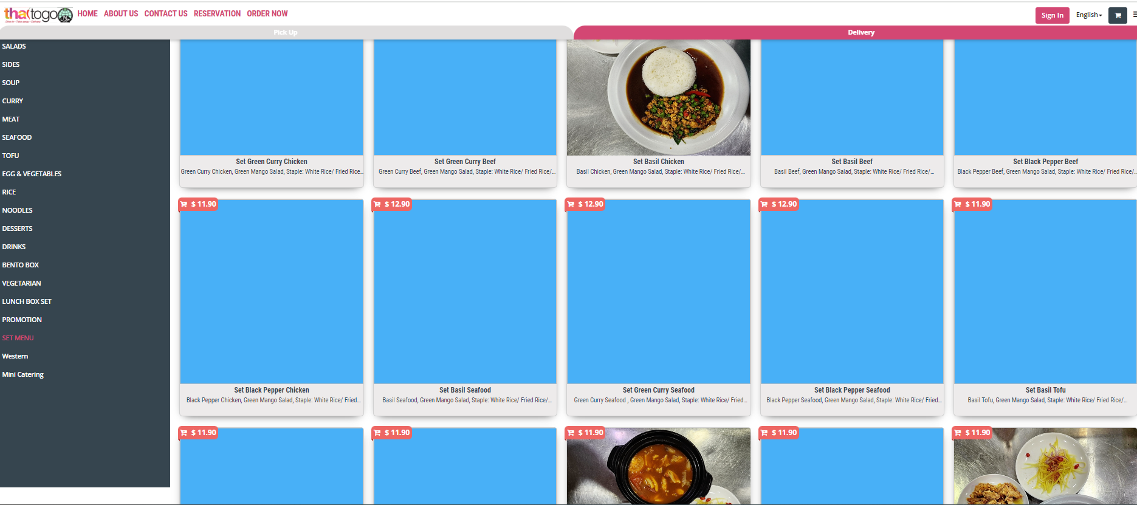
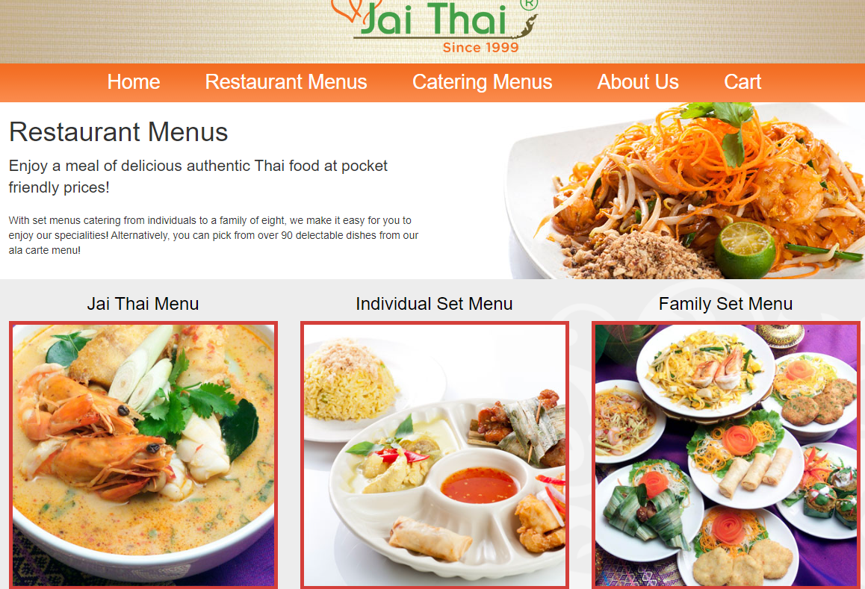

Competitive Analysis – Web https://www.jai-thai.com/ http://thaitogo.sg/12/Home

Slide 21
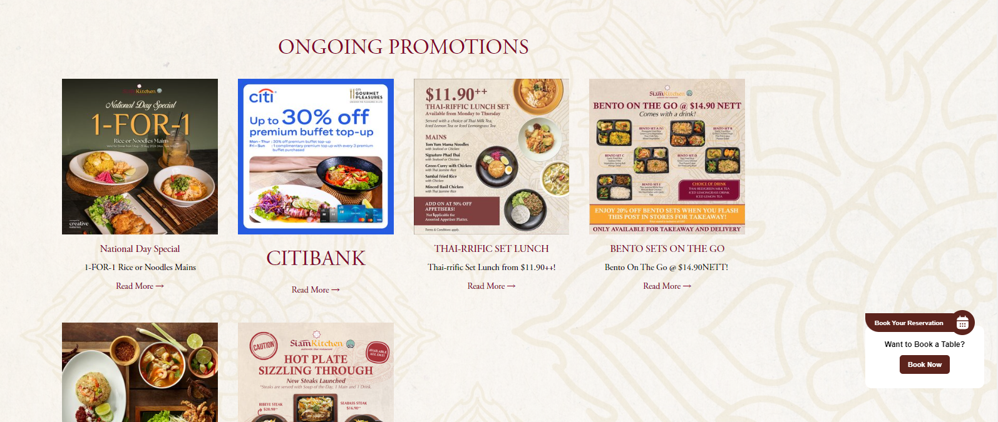
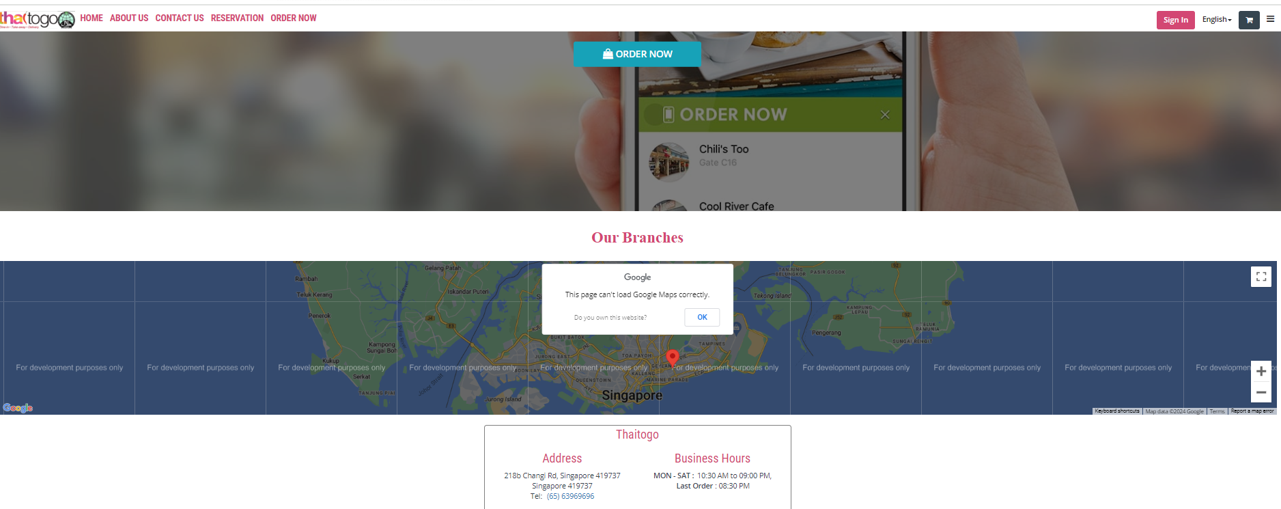
Competitive Analysis – Web https://www.siamkitchen.com.sg/ http://thaitogo.sg/12/Home

Slide 22
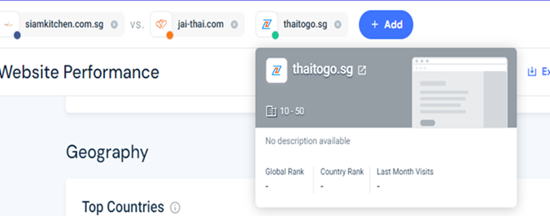
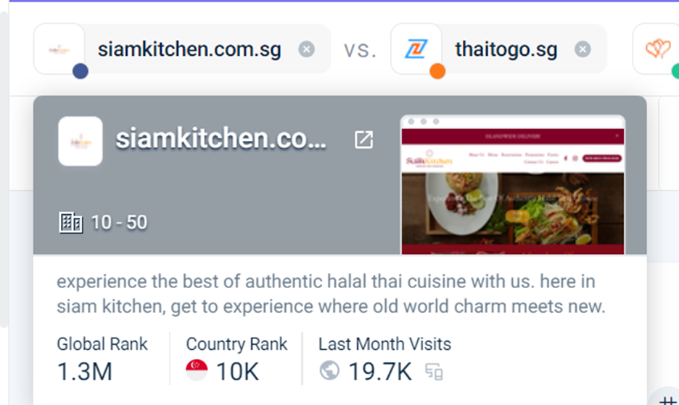
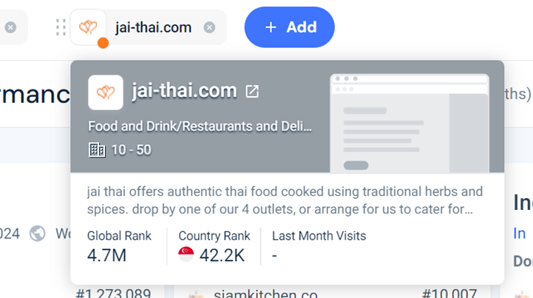
Competitive Analysis – Web Country Rank in Singapore --- Thai To Go no record

Slide 23
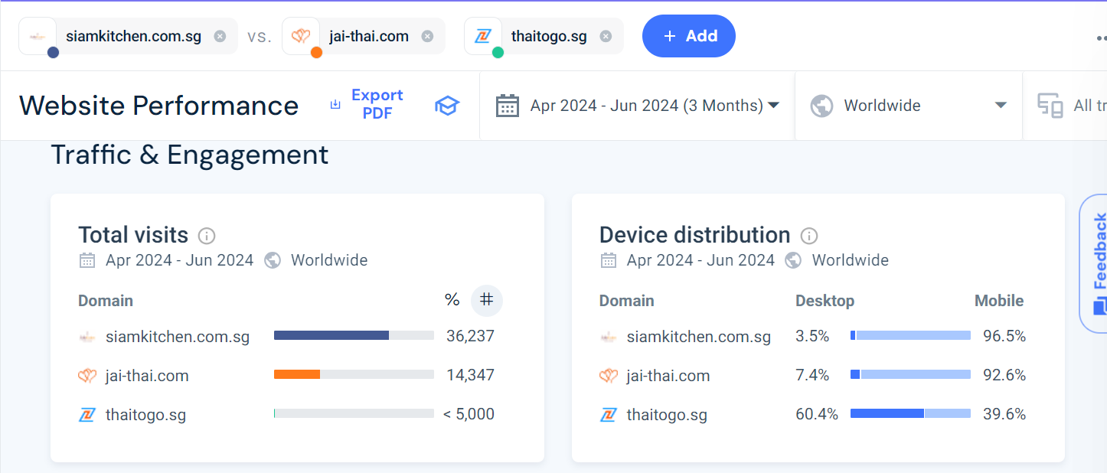
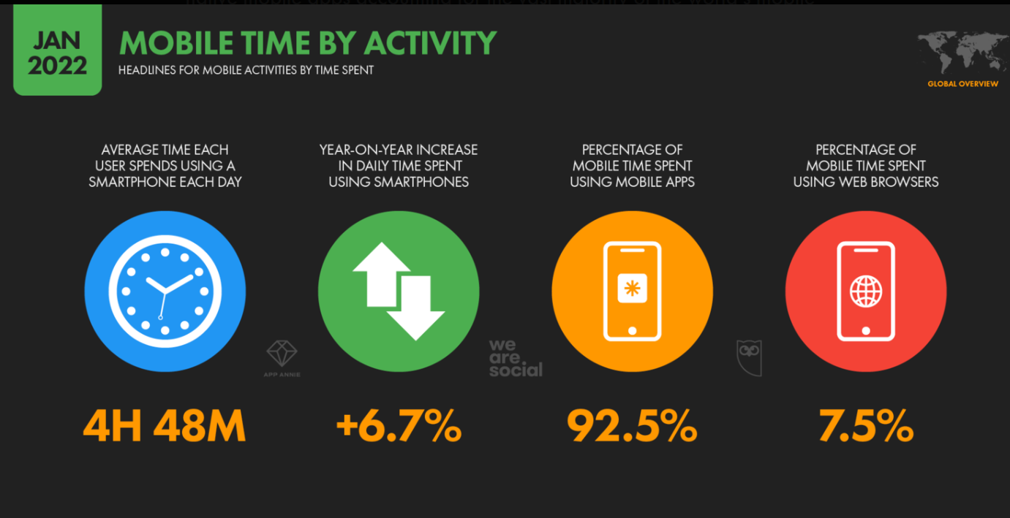
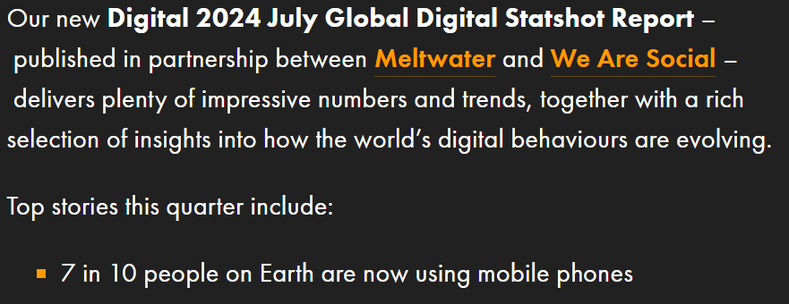
Competitive Analysis – Web
Thai To Go much lower than the other two – Device distribution (Mobile）
(The number of mobile phone users increases year by year, and most people use their mobile phones to do many things, including ordering food online.)
ber of mobile phone users increases year by year, and most people use their mobile phones to do many things, including ordering food online.obile phone users increases year by year, and most people use their mobile phones to do many things, including ordering food online.ne users increases year by year, and most people use their mobile phones to do many things, including ordering food online.number of mobile phone users increases year by year, and most people use their mobile phones to do many things, including ordering food online.

Slide 24
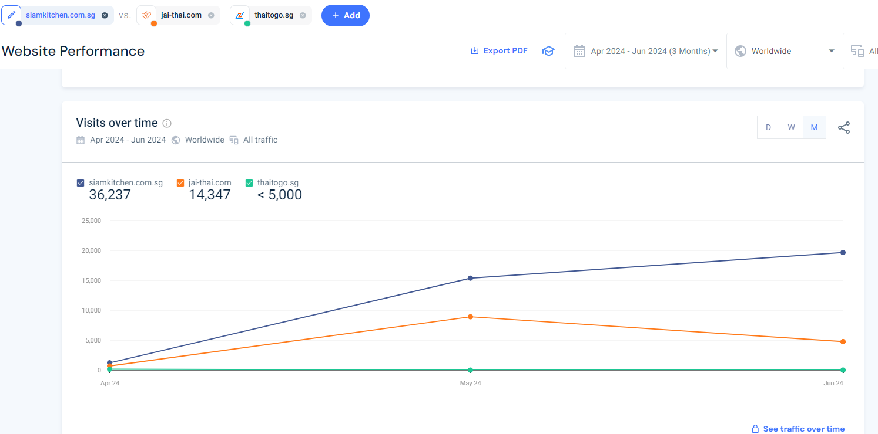
Competitive Analysis – Web
Thai To Go much lower than the other two -- All traffic

Slide 25
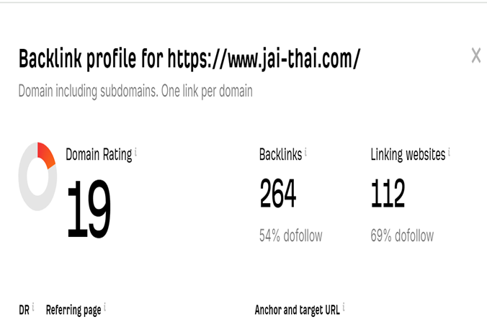
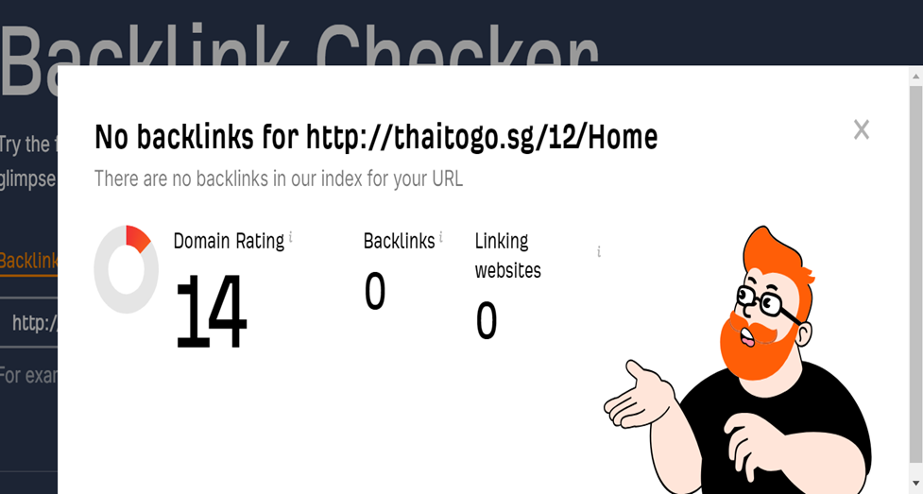
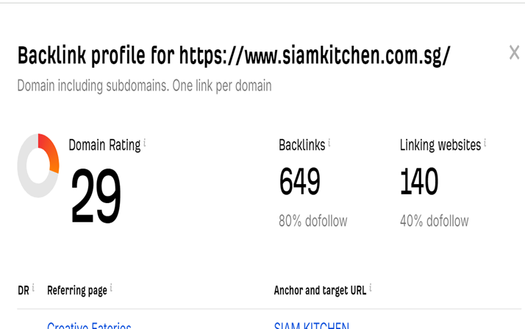
Competitive Analysis – Web 0 Backlink – Thai To Go

Slide 26
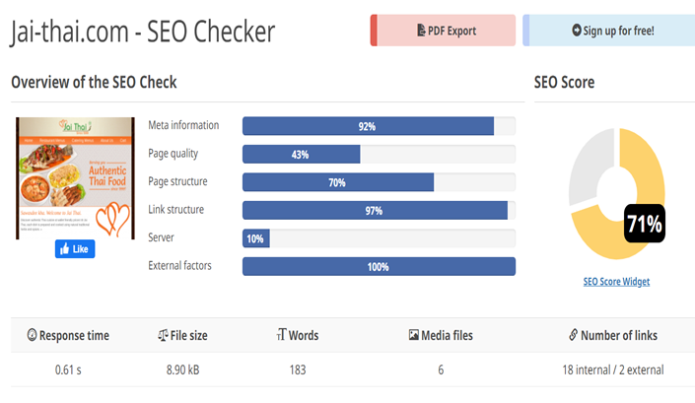
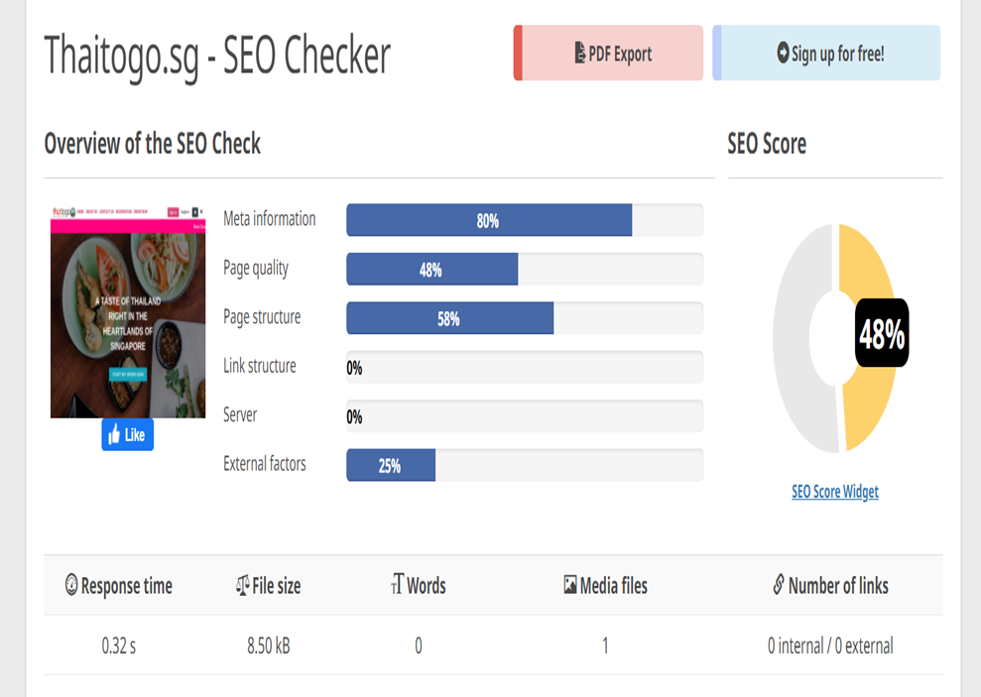
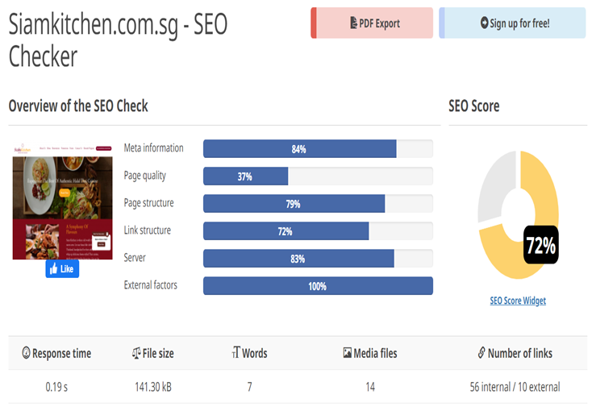
Competitive Analysis – Web SEO Score lower than other two (Thai To Go 48%, Jai Thai 71%, Siam Kitchen 72%)

Slide 27

Table – Web Analysis
Metric | siamkitchen.com.sg | thaitogo.sg | jai-thai.com
Backlinks | 649 (80% do follow) | 0 ( much lower ) | 264 (54% do follow)
Linking Websites | 140 (40% do follow) | 0 ( much lower ) | 112 (69% do follow)
Meta Information Quality | 84% | 80% ( lower ) | 92%
Page Quality | 37% | 48% ( higher ) | 43%
Page Structure | 79% | 58% ( lower ) | 70%
Link Structure | 72% | 0% ( much lower) | 97%
Domain Rating | 29 | 14 ( lower ) | 19
SEO Score | 72% | 48% ( lower ) | 71%

Slide 28
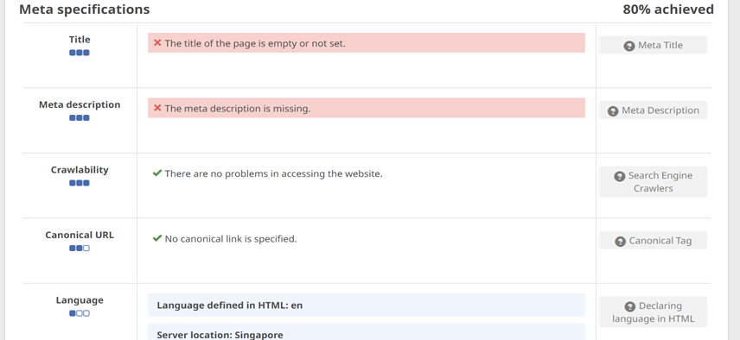
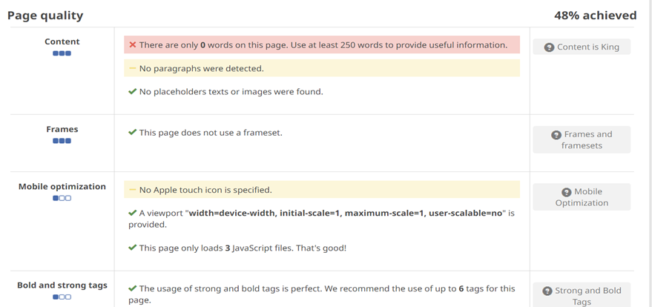
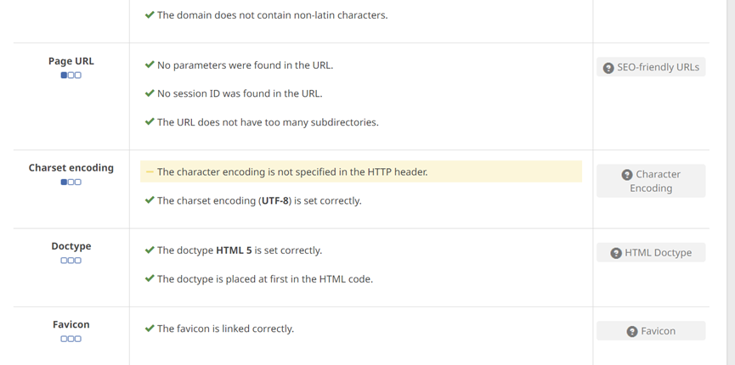
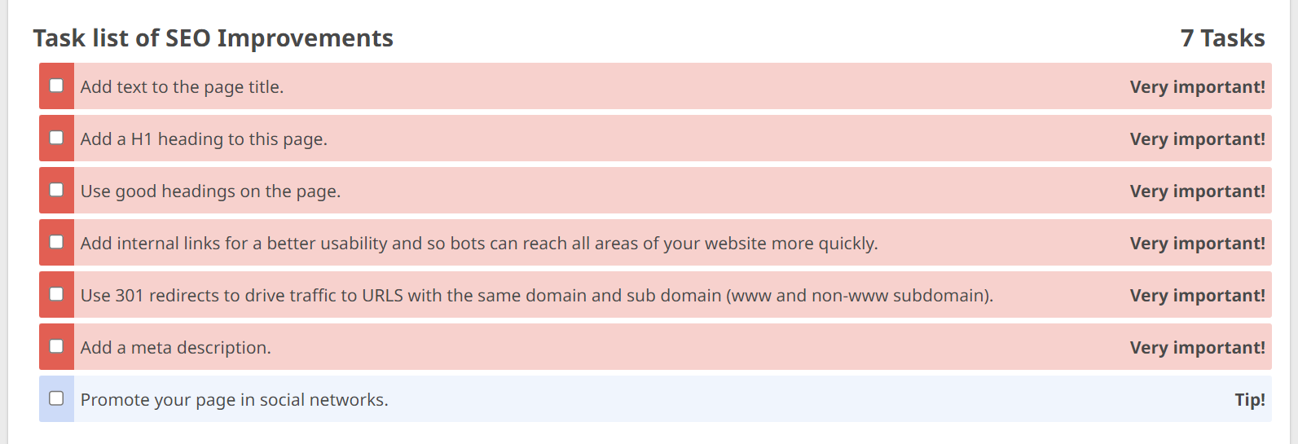
SEO Improvement Area – Thai to go

Slide 29
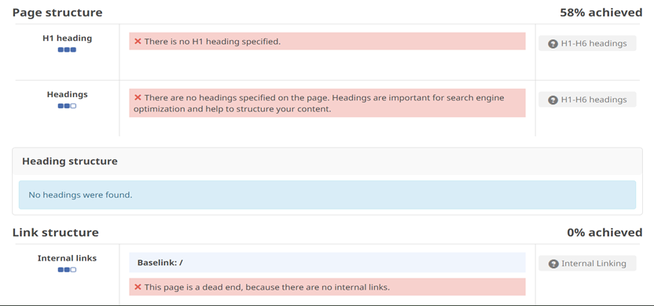
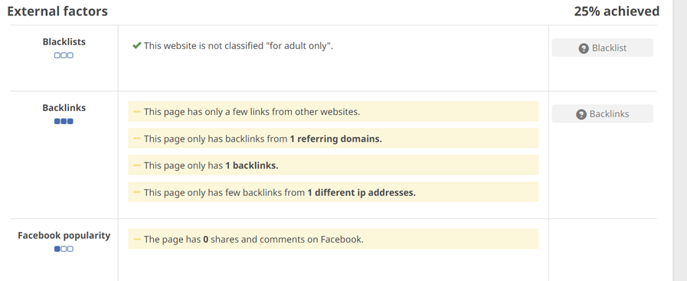
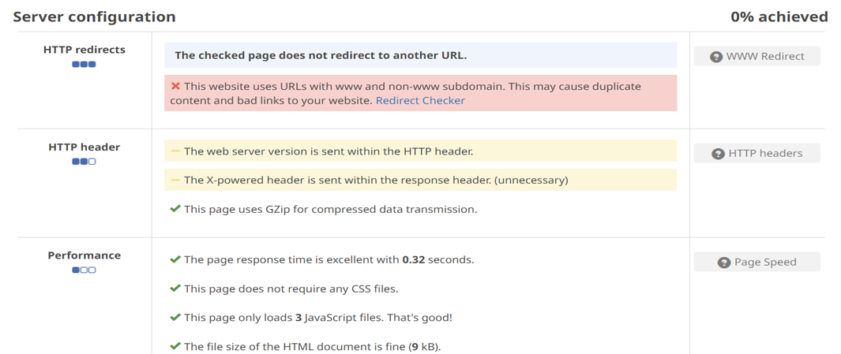
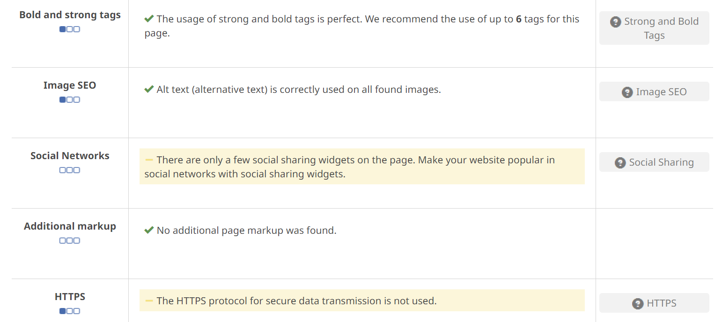
SEO Improvement Area – Thai to go

Slide 30
Summary
Competitors:
SiamKitchen.com.sg
---Excels in user engagement metrics such as visit duration, bounce rate, and pages per visit, along with having a strong backlink profile, high domain rating, and excellent SEO scores.
Jai-Thai.com
---Also shows strengths in domain rating, backlinks, and SEO scores.
ThaiToGo.sg
---The colors of the online menu images are not complete and clear
---0 backlinks
---Low engagement of user-generated content such as reviews and testimonials

Slide 31
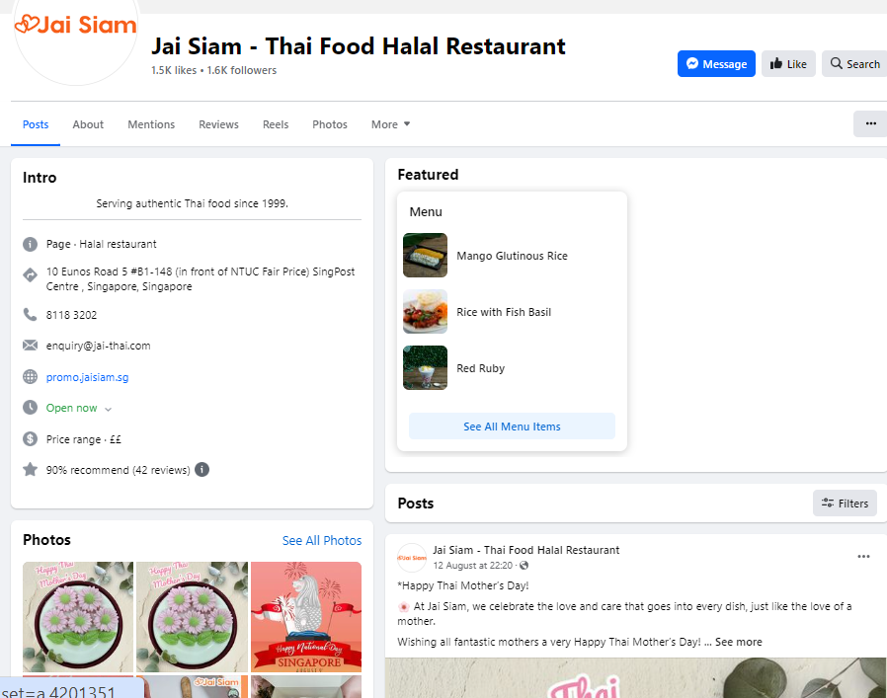
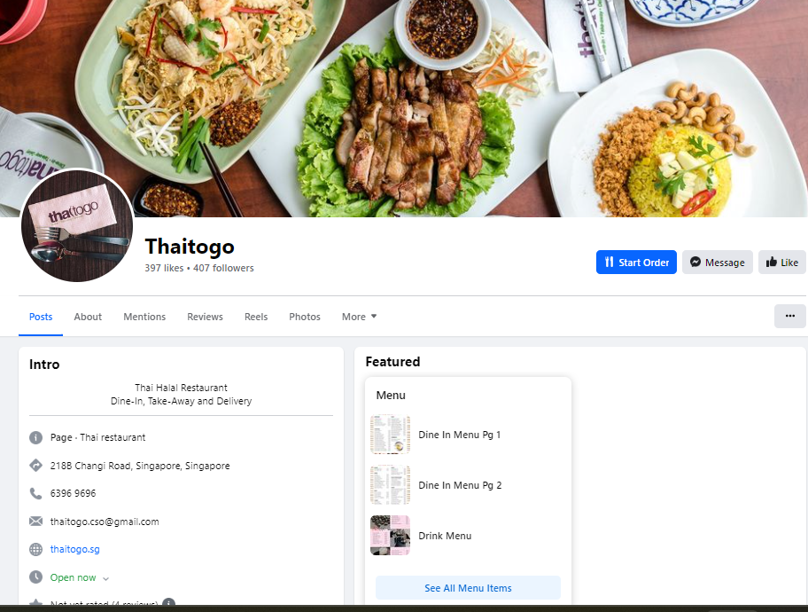
Competitive Analysis - Social Media (Facebook ) https://www.facebook.com/JaiSiamSG https://www.facebook.com/Thaitogo.sg/
1.5k likes, 1.6k followers
397 likes, 407 followers

Slide 32
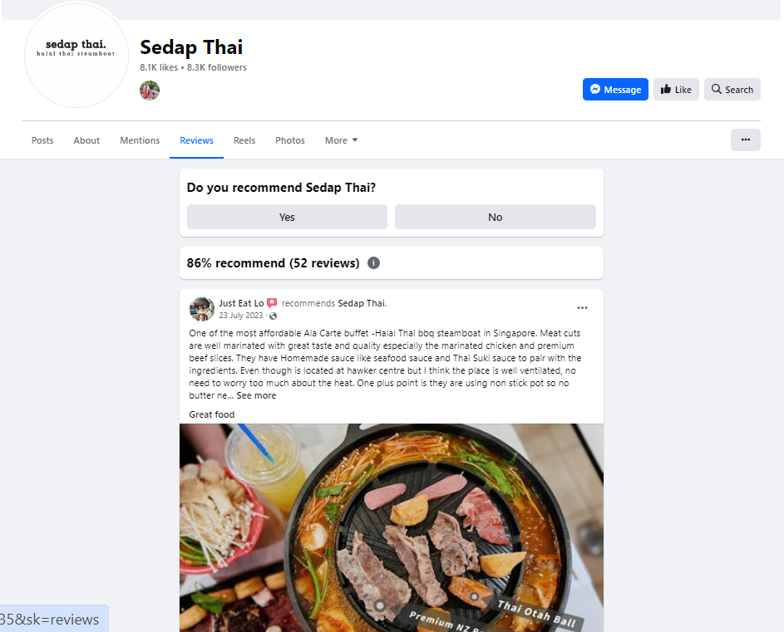
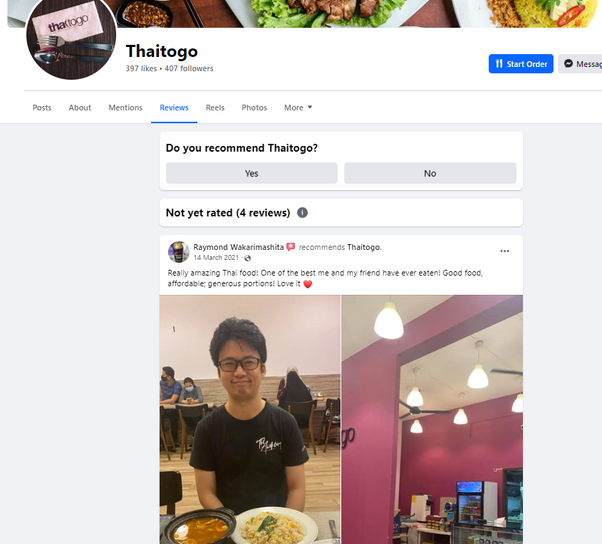

Competitive Analysis - Social Media (Facebook) https://www.facebook.com/p/Sedap-Thai https://www.facebook.com/Thaitogo.sg/
86% recommend (52 reviews)
Not yet rated (4 reviews)

Slide 33
Comparison table - Facebook
Name of the Restaurant | Likes | Followers | Reviews | Rate of Recommend
Thai to go | 395 | 406 | 4 | Not yet rated
Jai Siam | 1.5k | 1.6k | 42 | 90%
Sedap Thai | 8.1k | 8.3k | 55 | 86%

Slide 34
Competitive Analysis – Facebook
Restaurant Name | Strengths comparison
Sedap Thai | Likes and Followers: 8.1k likes and 8.3k followers, indicating a significantly stronger online presence and larger potential customer base compared to . Review Engagement: High engagement with 86% of comments on 55 reviews, showing strong customer interaction and satisfaction. Visual Appeal: Use of high-quality photos and videos to showcase dishes and dining experiences, making the content more appealing and shareable. This is a significant strength in creating visually appealing content that attracts and engages followers.
Jai Siam | Event Participation: Active announcements and recaps of events, both within the restaurant and in the local community, highlighting social proof and community engagement. This helps build a stronger connection with visitors and enhances the restaurant’s reputation. Likes and Followers: 1.5k likes and 1.6k followers, indicating a stronger online presence. Review Engagement and Recommendations: With 90% of 42 reviews being positive, Jai Siam shows a high level of customer satisfaction and a strong base of loyal customers.
Thai To Go | Likes and Followers : 395 likes and 406 followers. Review Engagement: Only 4 reviews with no rating, indicating lower customer engagement and feedback. Event Participation: Does not have this level of community engagement on their Facebook page.

Slide 35
Areas for Improvement for Thai To Go - Facebook
Increase Likes and Followers: --- Implement strategies to grow the number of likes and followers on Facebook to build a larger online presence.
Enhance Visual Content: ---Post high-quality photos and videos of dishes, dining experiences, and behind-the-scenes content to make the page more visually appealing and engaging.
Boost Review Engagement: ---Encourage satisfied customers to leave reviews and engage with comments to build trust and credibility.
Community Engagement and Events: ---Participate in and promote local community events, and share announcements and recaps to show community involvement and build a stronger connection with followers.
Consistent Posting: ---Increase the frequency of posts to keep the audience engaged and informed about new menu items, promotions, and events
Conclusion:
Sedap Thai excels in online presence, customer engagement, and visual content.
Jai Siam is strong in community engagement and has a solid base of loyal customers with positive reviews.
Thai To Go can improve by focusing on growing their follower base, enhancing visual content, engaging more with customers, participating in community events, and posting consistently.

Slide 36
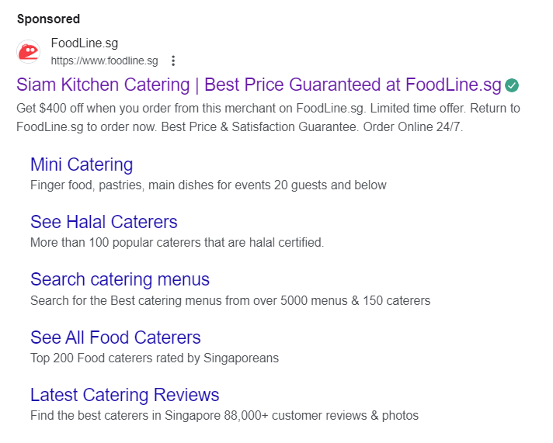
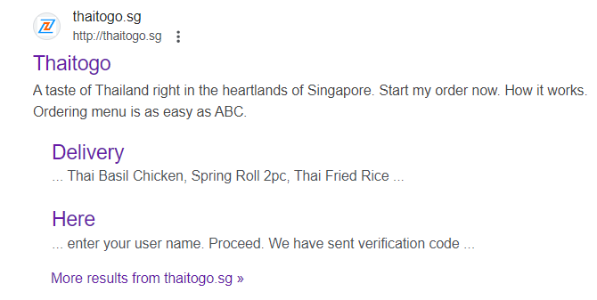
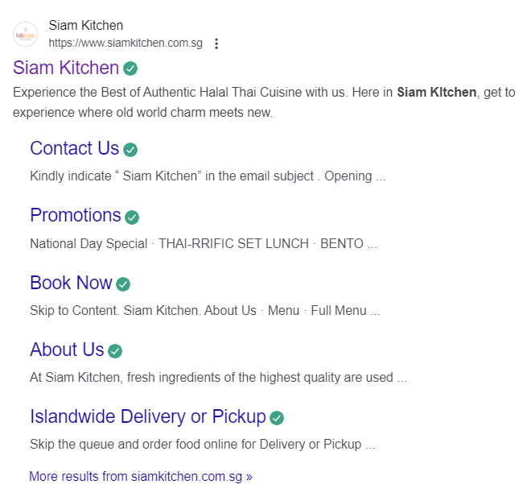
Competitive Analysis - Search Engine Marketing Analysis of Siam Kitchen & Thai To Go Description – breakdown clearly
Sponsored
Organic

Slide 37
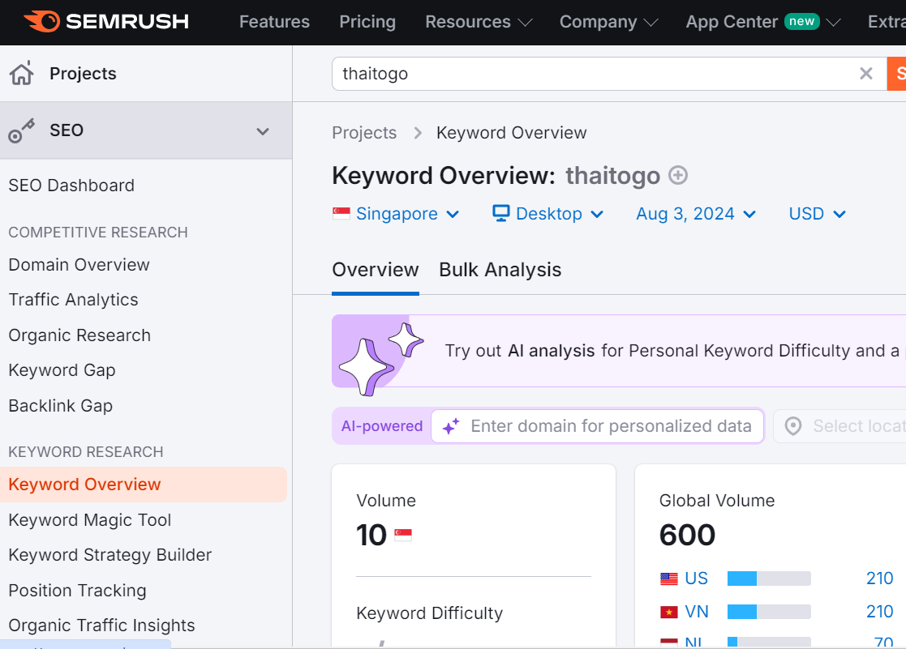
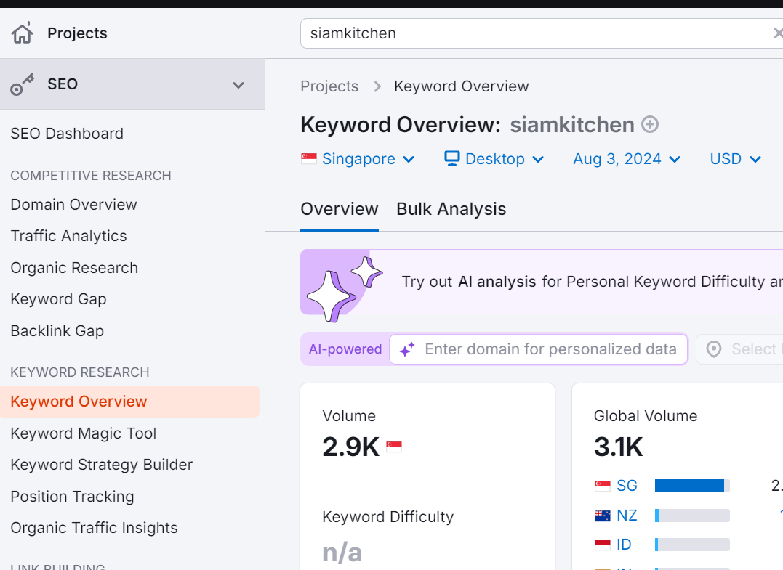
The Keyword Volume of Thai To Go much lower than Siam Kitchen’s
Competitive Analysis - Search Engine Marketing
Thai To Go “10”
SiamKitchen “2.9k”
YYYY

Slide 38
Summary
The Keywords are very important and will affect the restaurant's appearance rate when customers use Google to search for restaurant recommendations.
---Through analyzing Semrush data, Thai to Go only has 10 keyword searches in Singapore, which is much lower than the other two competitors (Siam Kitchen has 2.9k keyword searches, and Jai Thai has the highest keyword search volume of 3.6k)
---Thai To Go can improve its keyword strategy by focusing on specific, less competitive long-tail keywords (such as “Halal Thai food delivery Singapore") and naturally weave keywords into the content to ensure it is relevant and valuable to readers. Use location-based keywords such as "halal Thai restaurant near Eunos MRT station" to attract local traffic. And optimize Google My Business profile with accurate information and keywords.

Slide 39
Marketing Prioritization
High Impact | Costly to execute but potentially high impact, medium priority | Easy to execute and high impact, must be done, Top priority
 | ---Instagram Influencer Partnerships -----Leverages influencers to expand reach and build credibility. ---Potentially high, if content goes viral, but with the right influencers, costly and time-consuming to manage partnerships. | ---Website and Landing Page, Google Ads, Instagram Ads, Facebook Ads ---Essential for online presence, credibility, and converting visitors into customers, High impact, as it directly influences customer decisions
Low Impact | Costly to execute with low returns, do not execute | Easy to execute but not much impact on marketing results, low priority
 | ---Expensive Offline Advertising (e.g., Billboards, TV ads) ---High costs with low returns for a local restaurant, as it may not reach the target audience effectively. | ---Twitter Campaigns and LinkedIn Ads, Not as visually driven and lower engagement for food businesses. especially on LinkedIn the Platform not ideal for restaurant marketing. Easy to execute but not impactful.
 | High Cost to Execute | Low Cost to Execute

Slide 40
Customer Journey
Awareness: Aliyah’s journey with the brand starts when she discovers it through social media posts, Google ads, or SEO , searches like "Halal Thai Food Delivery Singapore."
Consideration: She interacts with the brand through the website, email marketing, or retargeting ads, and might even visit the restaurant.
Decision: She completes her order through a user-friendly online system, social media, or WhatsApp.
Throughout this journey, the marketing materials will address her needs by promoting affordable family meals, fast delivery, halal certification, and how easy it is to order.

Slide 41
Customer Journey (Content)
Customer Lifecycle Stage | Digital Marketing Channels | Content Ideas (Copywritten titles)
Awareness | Social Media (Instagram, Facebook) Google Ads SEO/SEM | --- "Searching for Halal Thai Food Near Me? Discover Thai To Go!" ---"Searching for Authentic Halal Thai Food? Start Here!“ --- "Halal Thai Food Delivery – Convenient, Delicious, and Right to Your Doorstep"
Consideration | Website Email Remarketing Restaurant Visit | ---"Enjoy 10% off your first order. Click to learn more!“ ---"Enjoy a Family Feast at Thai To Go! Get 10% off on your next order with this code.” ---"Missed out on our delicious Thai dishes? Come back and enjoy 10% off your next meal!“ ---"Visit us today and enjoy a free dessert for the kids with every family meal!"
Decision | Online Ordering System Social Media Direct Messages WhatsApp | ---"START MY ORDER NOW: Enjoy Fresh, Authentic Halal Thai Food Delivered to You” ---"Order online and get free delivery on your first purchase!" ---"Call or WhatsApp us to place your order”

Slide 42
Marketing Funnel
Attention
01
Channels: Social Media Post &Ads, Blog Posts, SEO
Content: "Did You Know? Thai To Go Offers Authentic Halal Thai Food for Delivery!"
Interest
02
Channels: Website, Facebook, Instagram
Content: "Explore Our Menu - Delicious Halal Thai Food Perfect for you and your families."
Desire
03
Channels: Google Remarketing, Facebook
Remarketing, Instagram, Facebook Events
Content: "Tried the new family meal at Thai To Go and it was amazing!
Action
04
Channels: Website, Phone, WhatsApp
Content: "Order online and get free delivery on your first purchase!"

Slide 43
Marketing Execution

Slide 44
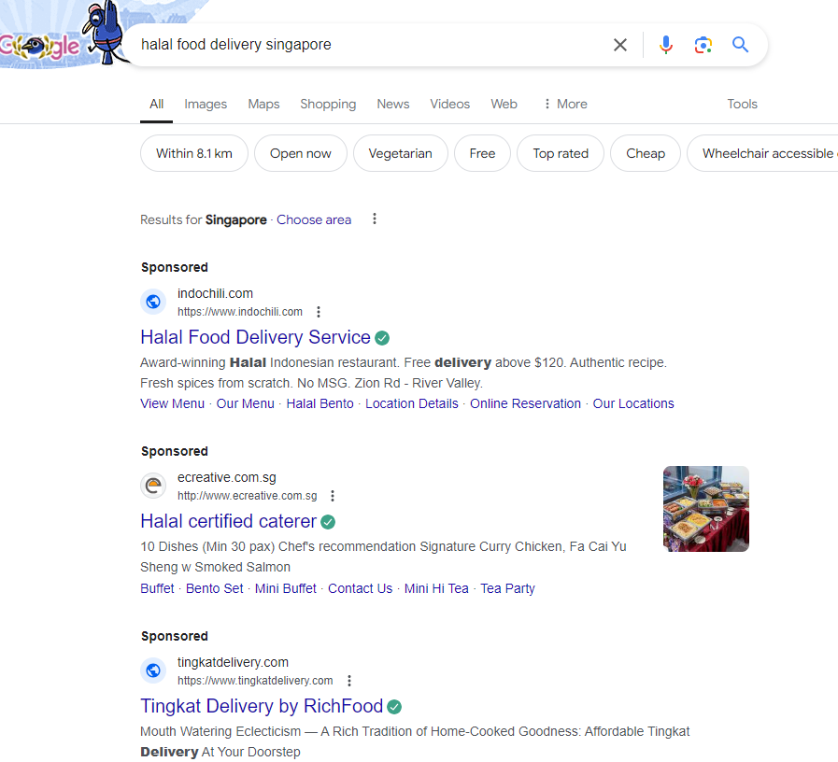
SEM - Google Search Ads

Slide 45
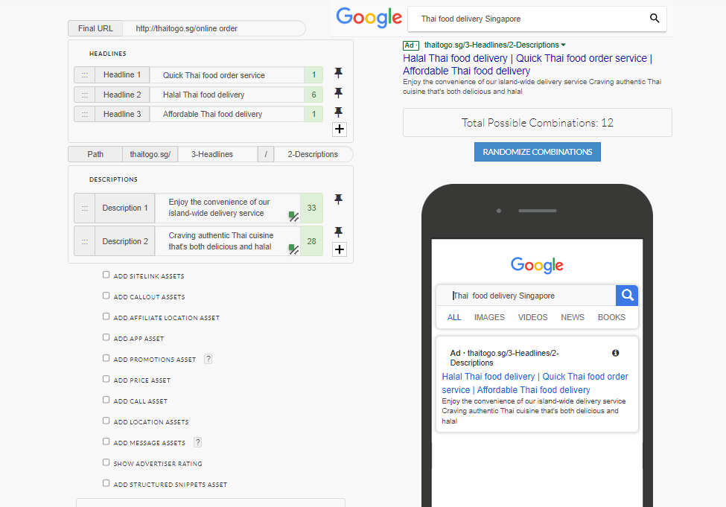
SEM - Google Search Ads (Ad mockups)

Slide 46
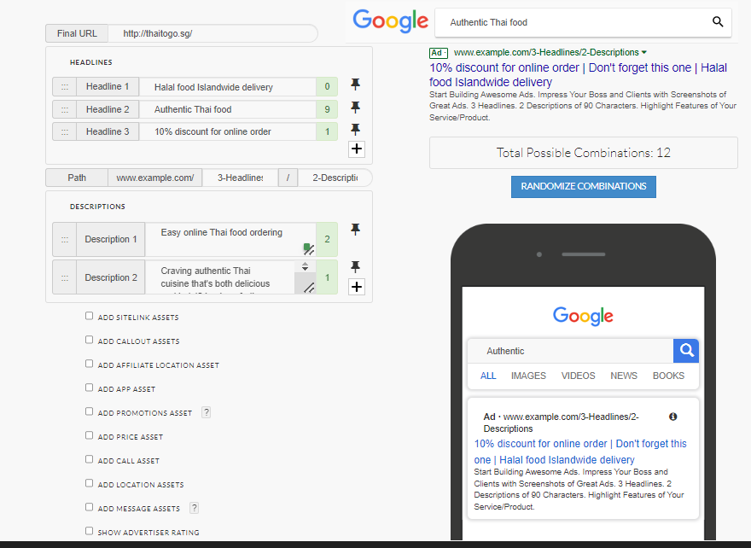
SEM - Google Search Ads (Ad mockups)

Slide 47
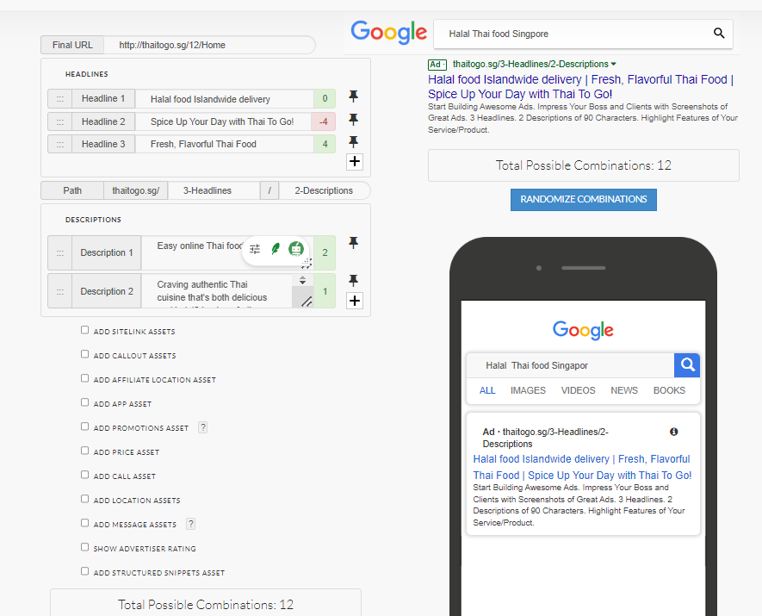
SEM - Google Search Ads (Ad mockups)

Slide 48
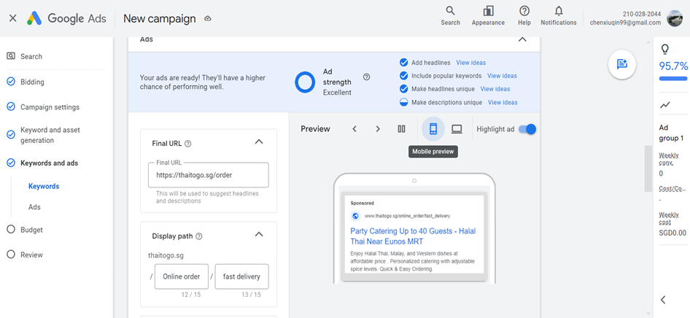
SEM - Google Search Ads

Slide 49
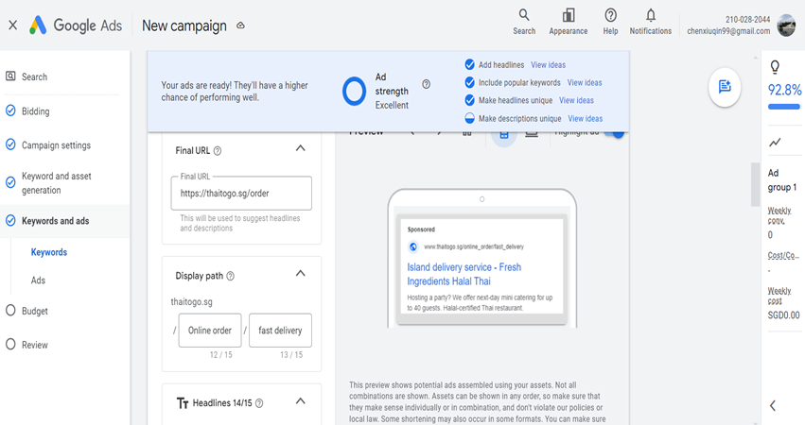
SEM - Google Search Ads

Slide 50
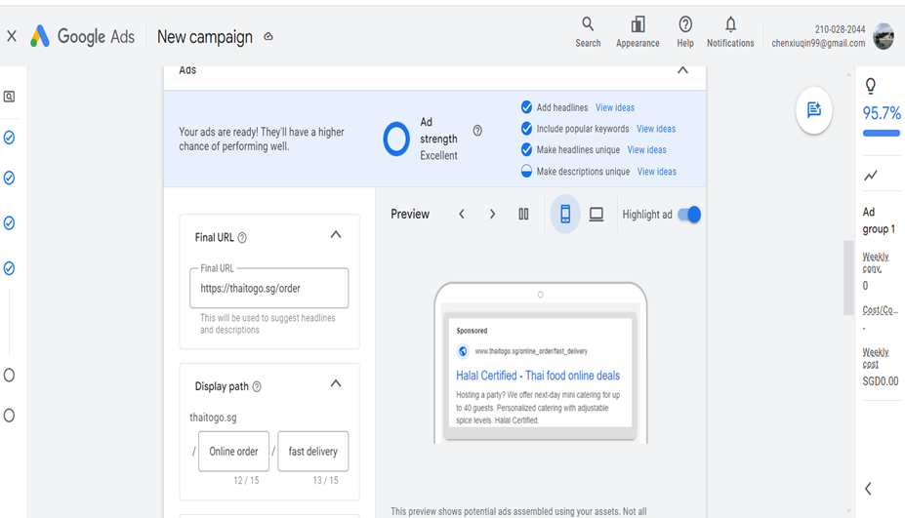
SEM - Google Search Ads

Slide 51
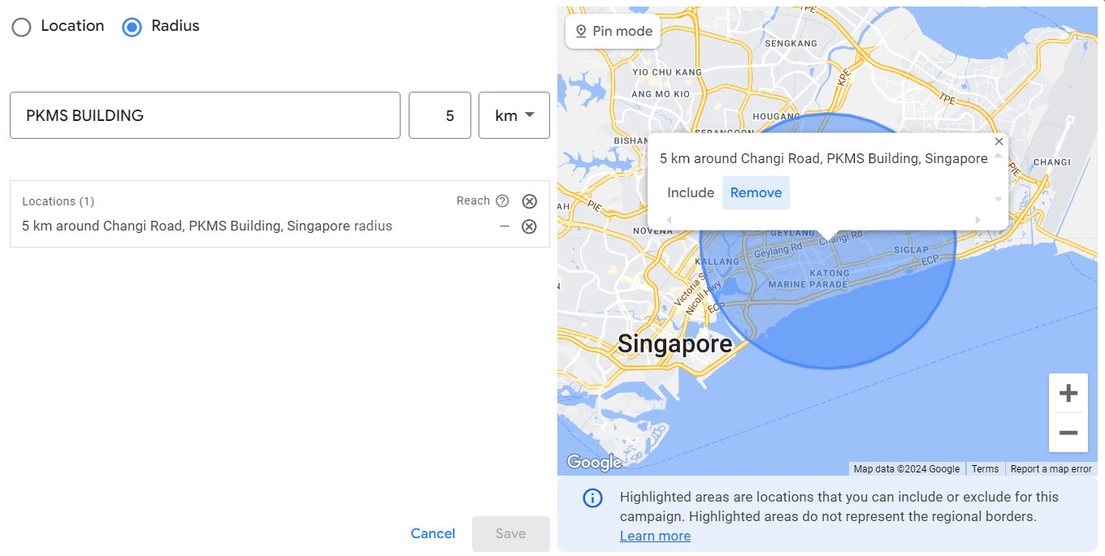
SEM - Google Search Ads (Target Audience)

Slide 52
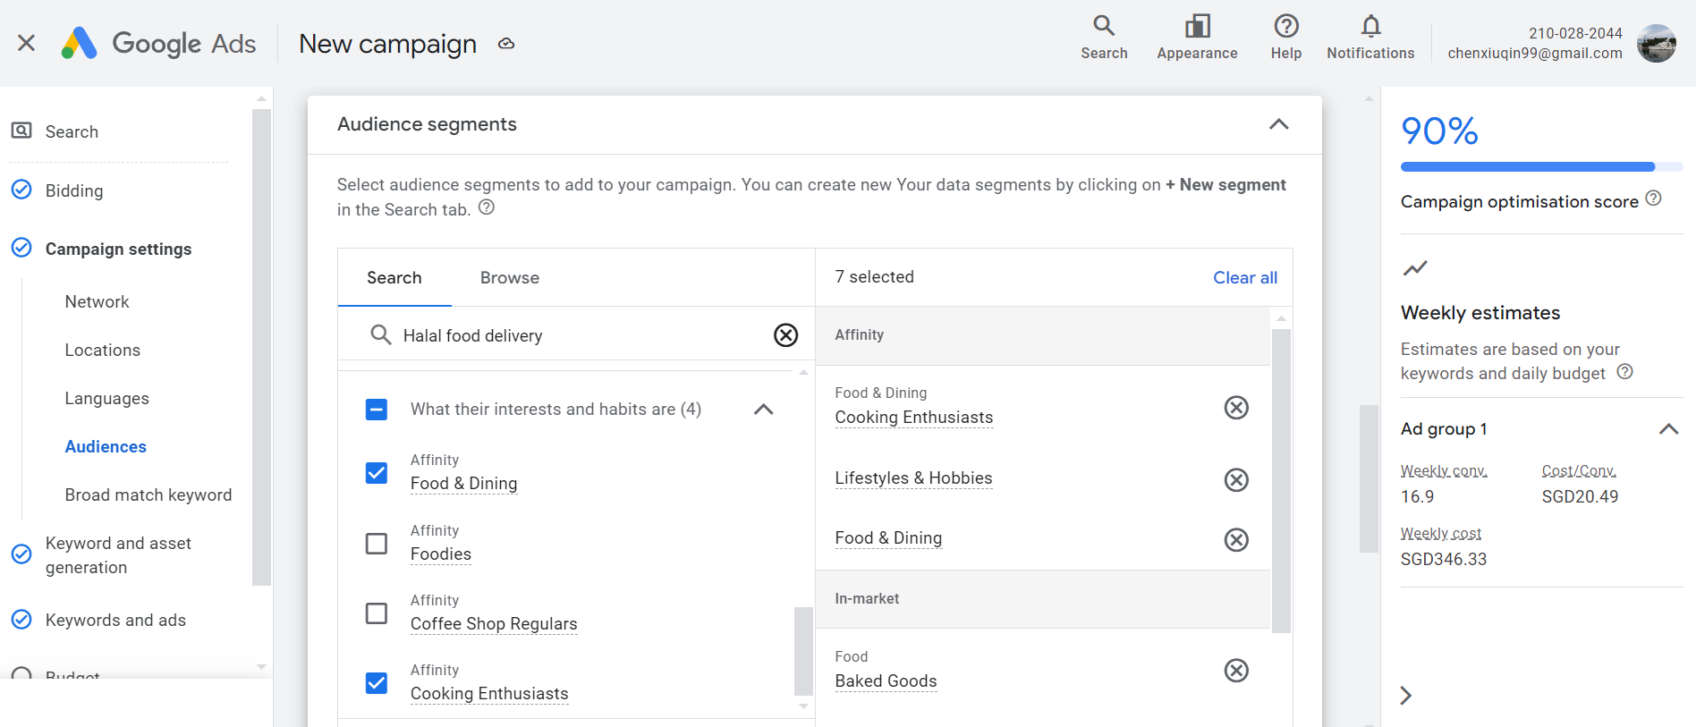
SEM - Google Search Ads (Target Audience)

Slide 53
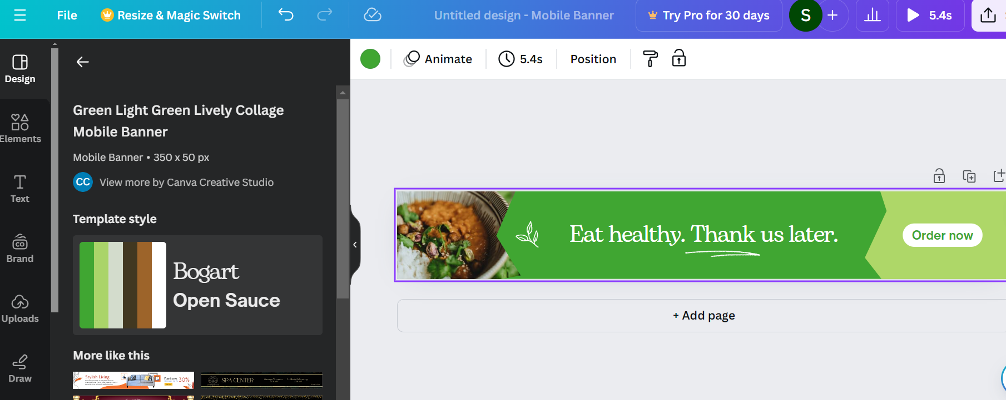
Search Engine Marketing (Google Display Network Ads) Mobile Banner Ad

Slide 54
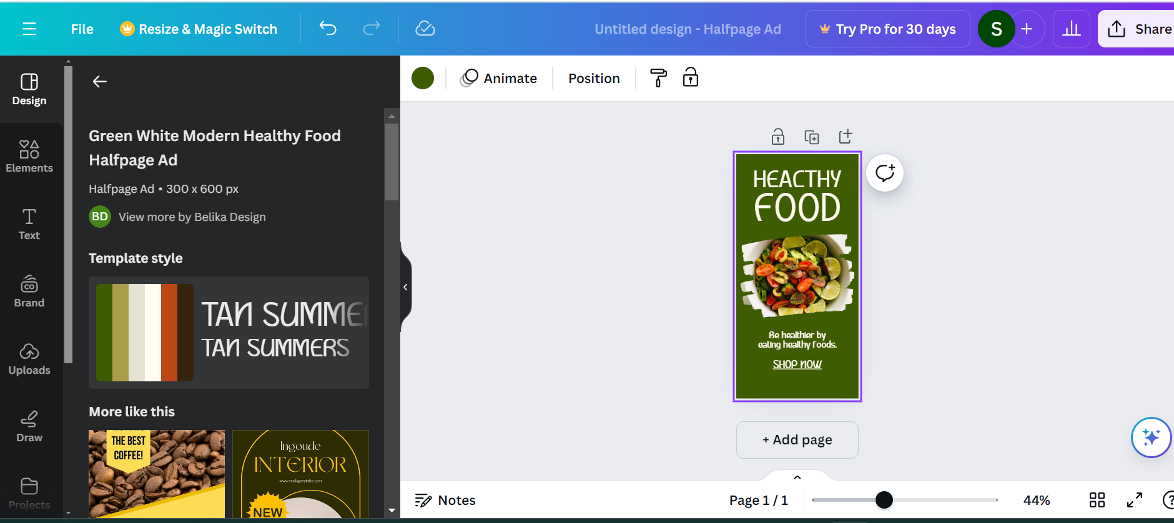
Search Engine Marketing (Google Display Network Ads) Halfpage Ad

Slide 55
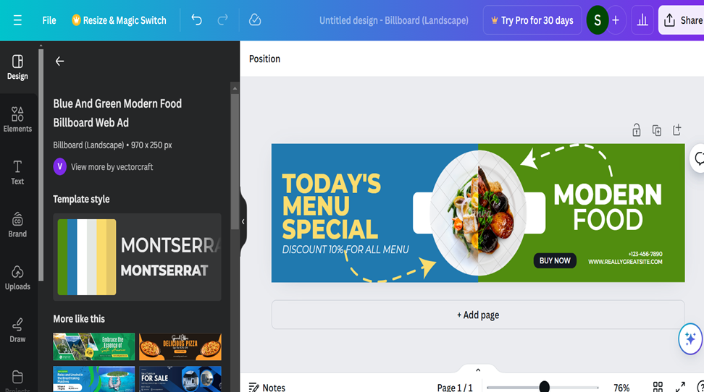
Search Engine Marketing (Google Display Network Ads) Billboard Ad

Slide 56
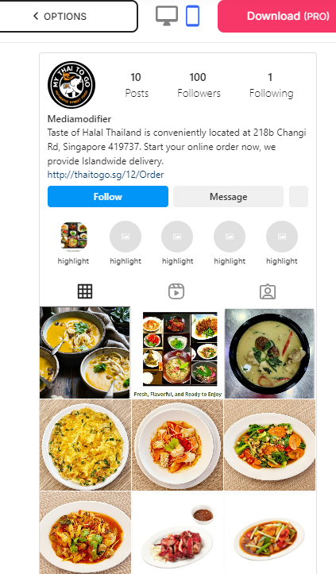

Instagram Mobile Instagram Desktop
Social Media Marketing (Organic Post)

Slide 57

Social Media Marketing -- Organic Post (Facebook)

Slide 58

Landing Page

Slide 59




Landing Page - Mode of Mobile

Slide 60

Landing Page

Slide 61

Landing Page

Slide 62

Landing Page –

Slide 63

Landing Page

Slide 64

Landing Page

Slide 65

Landing Page

Slide 66

Landing Page

Slide 67

Landing Page

Slide 68

Landing Page

Slide 69

Landing Page

Slide 70

Landing Page

Slide 71

Landing Page

Slide 72
SMART Goals
Channel | Metric | KPI | Duration | Notes (if any)
Landing Page | Conversion Rate | +20% | in 3 months time | links for touch interactions.
Website | Number of Online Order | +20% | in 3 months time | User Experience: Simplify the navigation menu. Ensure important information (like contact details, menu)
Social Media Organic | Search Traffic (FB & IG) | +20% | In 3 months time | Regularly post engaging content such as promotions, new dishes.

Slide 73
KPIs and How They Will Meet Objectives:
Conversion Rate: Aim to increase conversions by 20% within 3 months by improving the website’s landing pages, making navigation easier, and having clear calls to action (CTAs).
Number of Online Orders: Target a 20% increase in online orders by 3 months, through a better user experience and focused promotions.
Social Media Engagement: Increase organic traffic and engagement by 20% on Facebook & Instagram within 3 months, by regularly posting engaging content like promotions and new dishes.
Customer Satisfaction: Measure satisfaction through feedback, focusing on service efficiency, food quality, and ease of ordering.
These key performance indicators (KPIs) are designed to help achieve the goal of increasing online orders while ensuring the marketing strategy meets the needs of our target customer.

Slide 74


Video Content --- Click to play

Slide 75

THE END

